Slide 1
Github Commands
Stuff you can do with the github app

Slide 2
Learning how to use the Git Hub App

Slide 3
The Git Hub App is a GUI interface to complement the git bash console. It is especially friendly towards non-tech savvy users who are not used to writing programming codes. However the trade-off with the user-friendly interface is the limited functional capability. For more advanced users, they may find the Git Hub App not very satisfying. In this tutorial, you will be learning the features that the Git Hub App provides.

Slide 4
Git Hub App Features
Creating a Repository
Viewing your Repo Status
Committing your changes
Rolling back and reverting commits
Switching branches
Merging branches
Publishing branches
Syncing local and remote branches

Slide 5
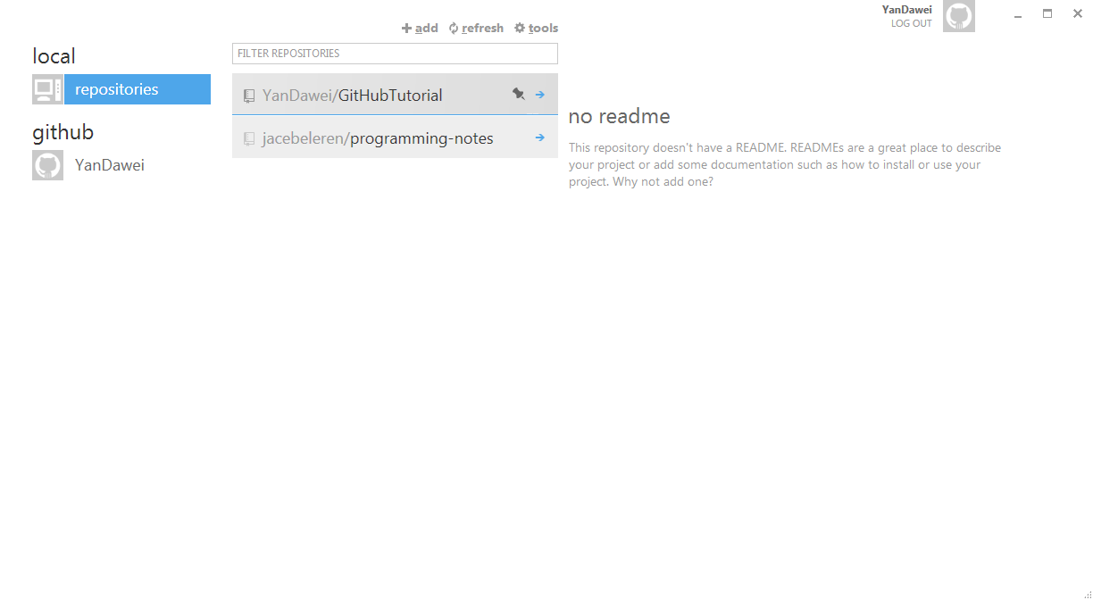
Creating a Repository
To create a new repo, click on the add sign.
All your repos will be shown here in this list, if you created any.
You should get to a page like this after you login to the Git Hub App. At this page you are able to create a new repo and view all your available repos in your local computer and in your git hub account.

Slide 6
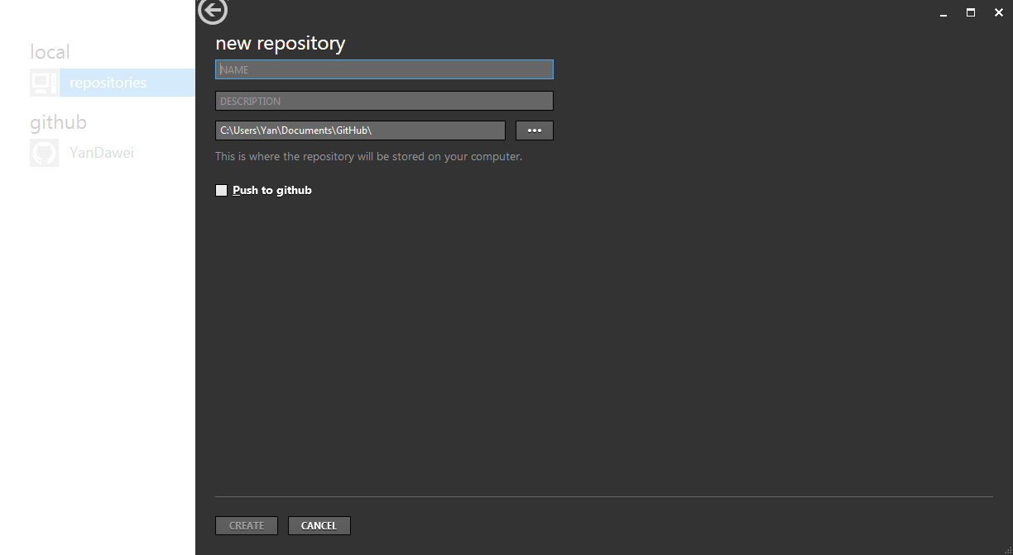
Creating a Repository
Name of repo
Description of repo
Directory pathway of your new repo in your local computer.
Checking this option will create this repo in your git hub account aka remote repo.
After you click on the add sign, you should get to this page where you key in your desired name and description for your new repo.

Slide 7
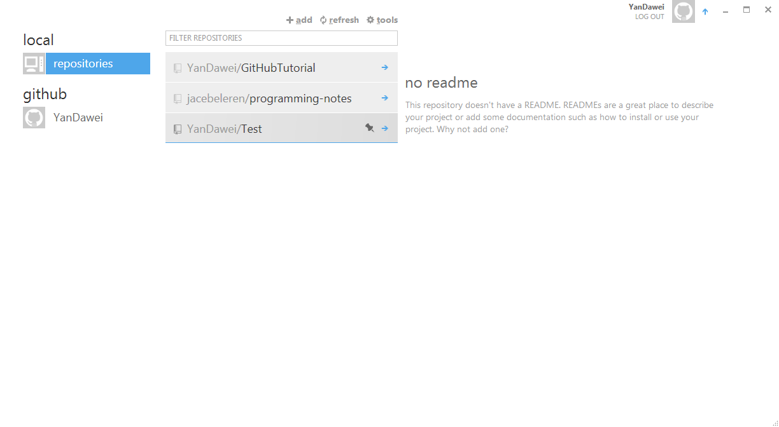
Creating a Repository
As you can see I have created a new repo called test.

Slide 8
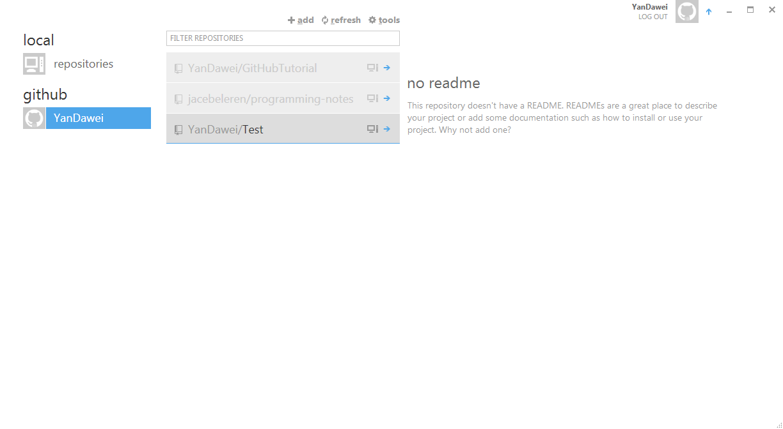
Creating a Repository
If you had checked the “push to git hub” option, you should also be able to notice the exact repo that you have just created in your git hub account.

Slide 9
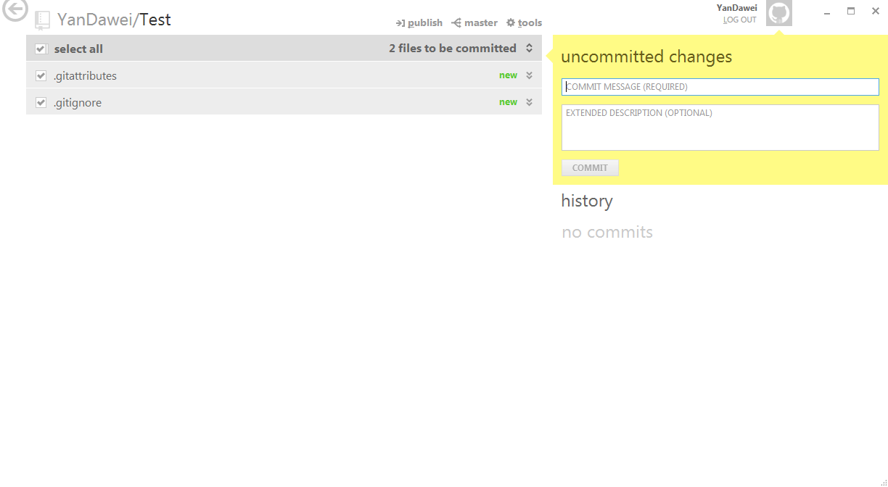
Viewing your Repo Status
You will be notified of any uncommitted changes here
This section will display all the historical commits
To view any of your repo status, double click on the repo. You should get to a page like this. In this example, I am looking at the test repo that I have newly created. Notice that there are two files that are automatically created upon creating a new repo. Do not worry; you will not need to make use of these files to carry out basic functionalities of Git Hub so you can choose to ignore them.

Slide 10
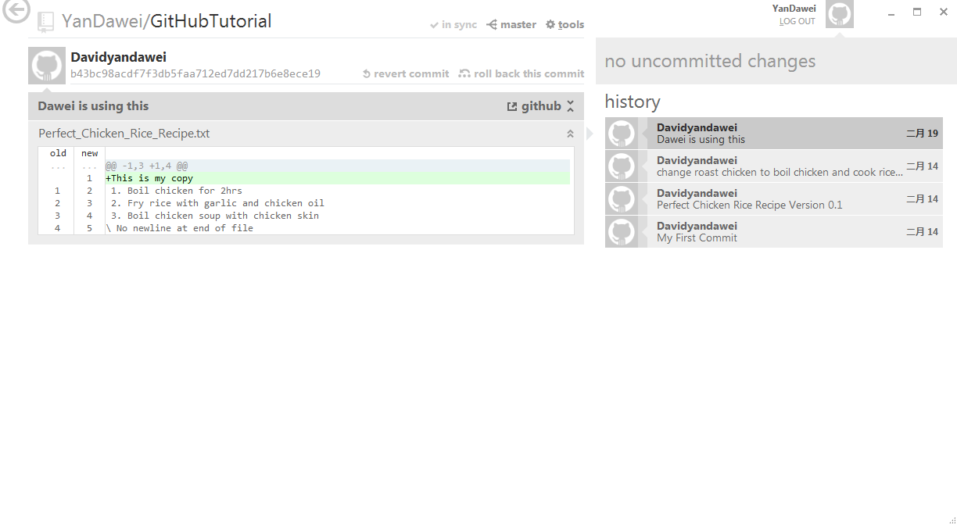
Viewing your repo status
After using your repo for quite some time and making some commits. It should look something like this screenshot.

Slide 11
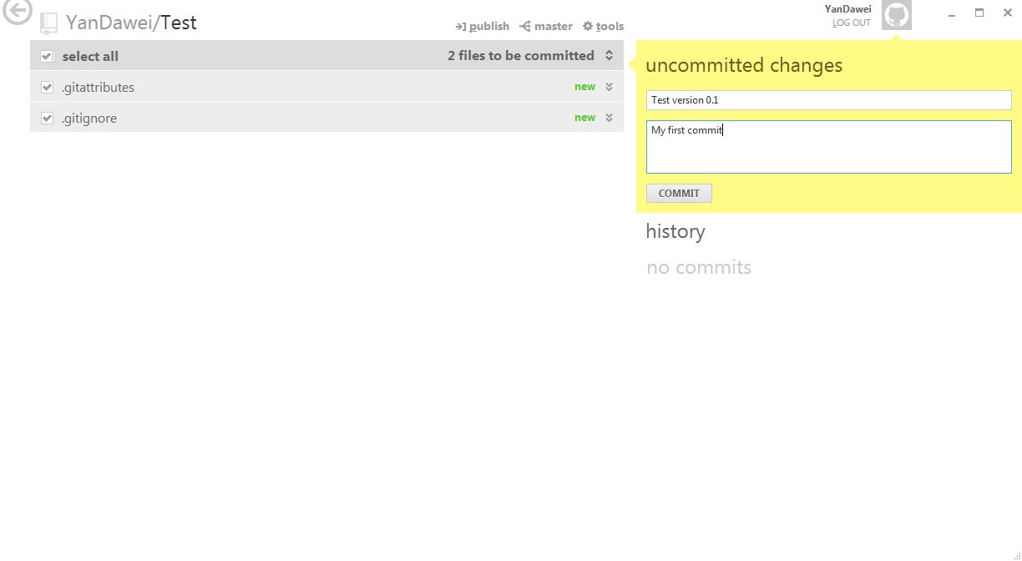
Committing your changes
Check the files you wish to commit
First row indicates your commit message; second row indicates the description of the commit.
Press this button when you are ready to commit your changes
Committing in Git is like telling Git to save this particular instance of the repo in time. It’s the same as saving your work document but the difference is git hub allows you to reference back to all the commits that you have made.

Slide 12
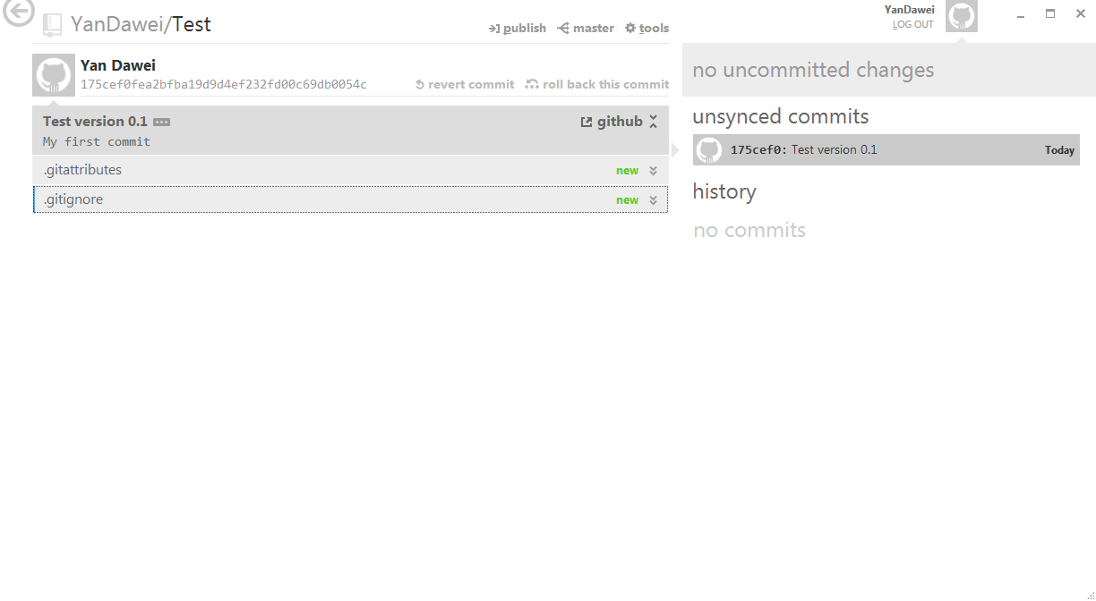
Committing your changes
The commit is currently unsynced as we have not publish the commit to git hub yet. We will get to that in the later sections.
After you commit you should see something like this screenshot.

Slide 13
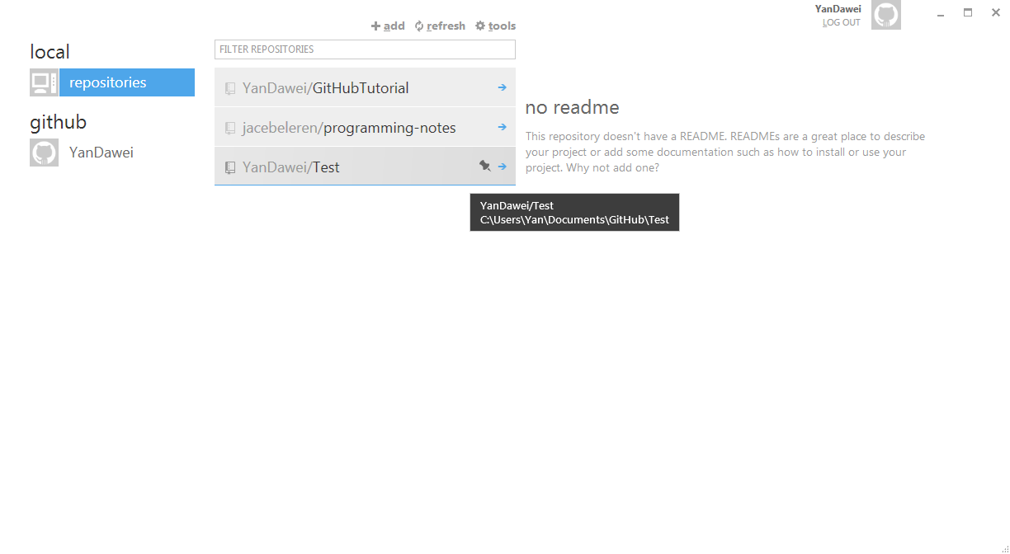
Committing your changes
Lets us try committing another change to better understand the committing process. First mouse over the repo to get the directory path of the repo aka the location of the repo in your local computer.

Slide 14
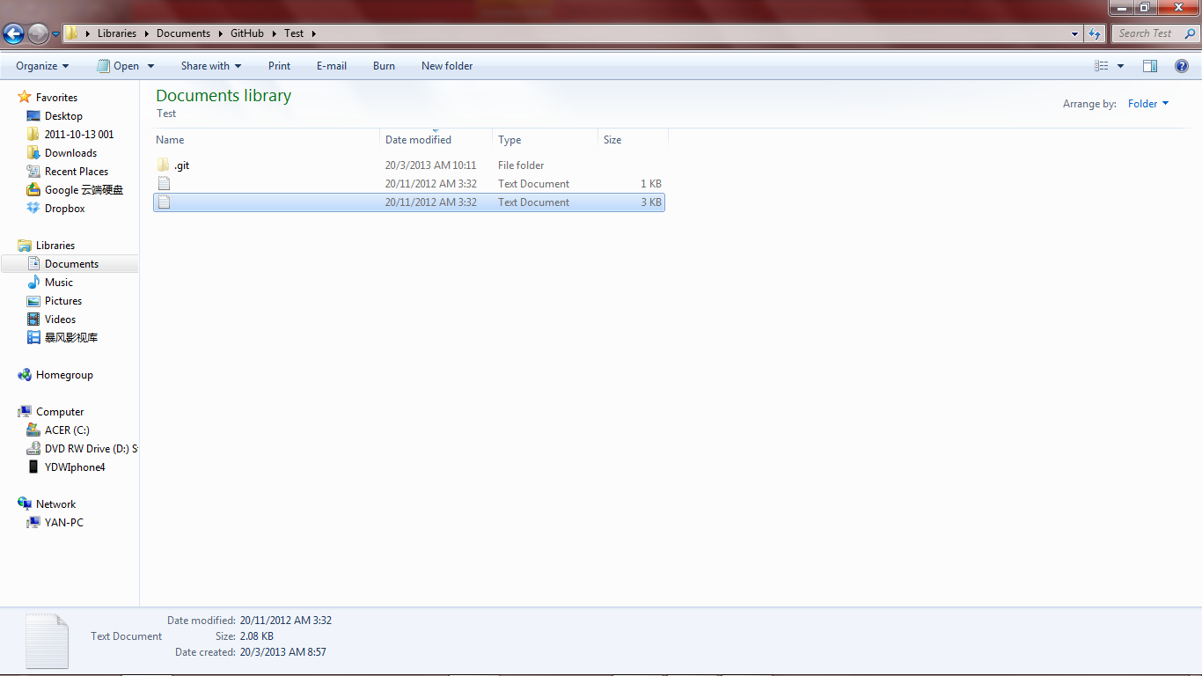
Committing your changes
After you navigate your way to the new repo, you should be able to see a hidden .git file and the two new files, gitignore and gitattributes.

Slide 15
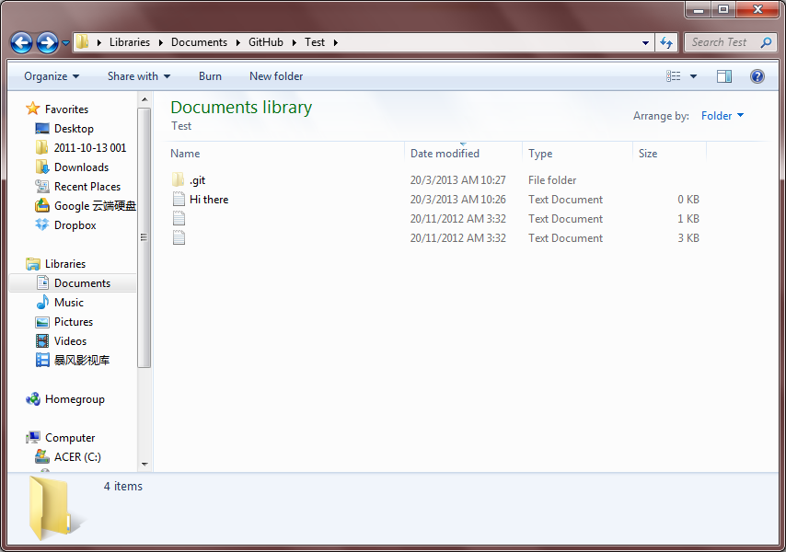
Committing your changes
I will then add new text file called Hi there.txt

Slide 16
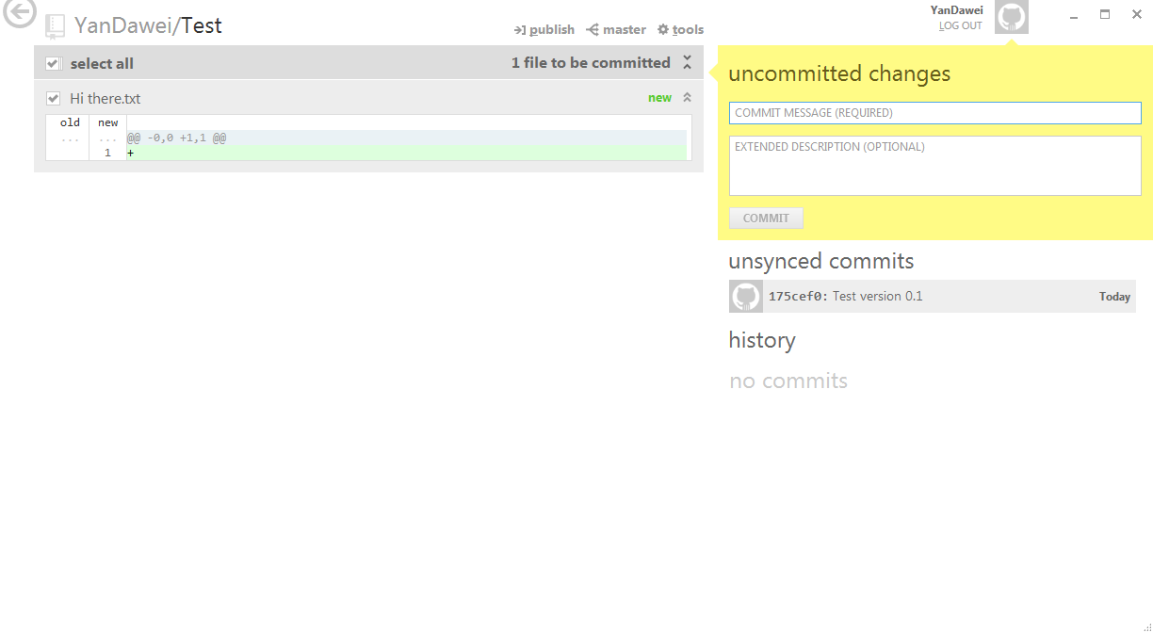
Committing your changes
This new change in the repo will be automatically reflected in git hub application.

Slide 17
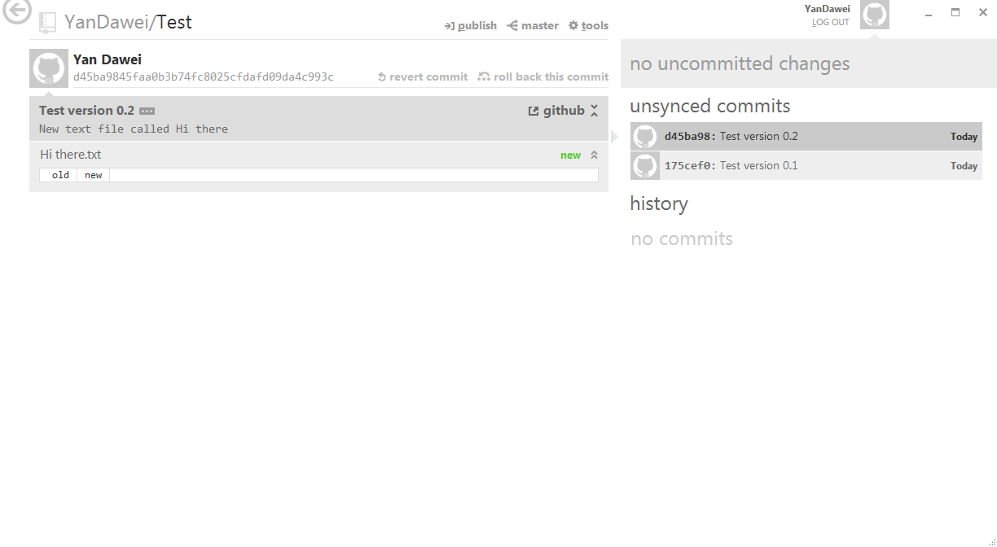
Committing your changes
I then commit these change and your repo now should have two commits, first commit with only the two default files and the second with a newly added text file called Hi there.txt.

Slide 18
Committing your changes
Additional information: Conceptually, commits are similar to checkpoints which you can refer back to. Each commit will point to a certain state of the repo (commits only captures the changes in the repo) back in time. We will dwell more into that on the next chapter.

Slide 19
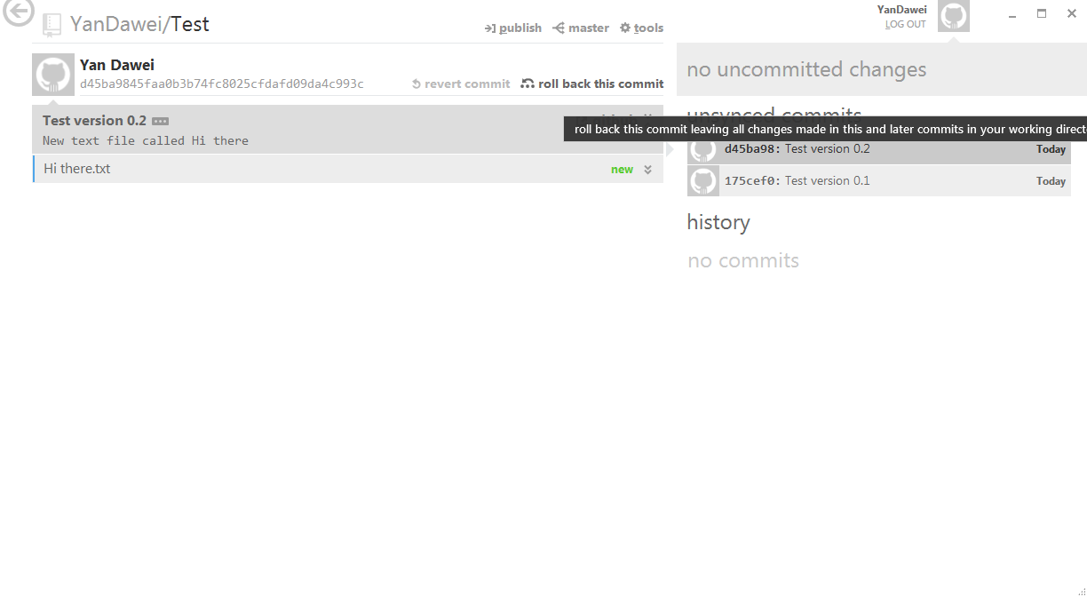
Rolling back and Reverting Commits
If you made an error, how do you correct your repo status by going back in time to certain historical commit? The roll back function in Git Hub will do just that.

Slide 20

Rolling back and Reverting Commits
In this screenshot I have rollbacked my most recent commit (the commit with the new Hi there.txt file). You can see that the rollback uncommits this commit however the text file will still be in your repo.

Slide 21
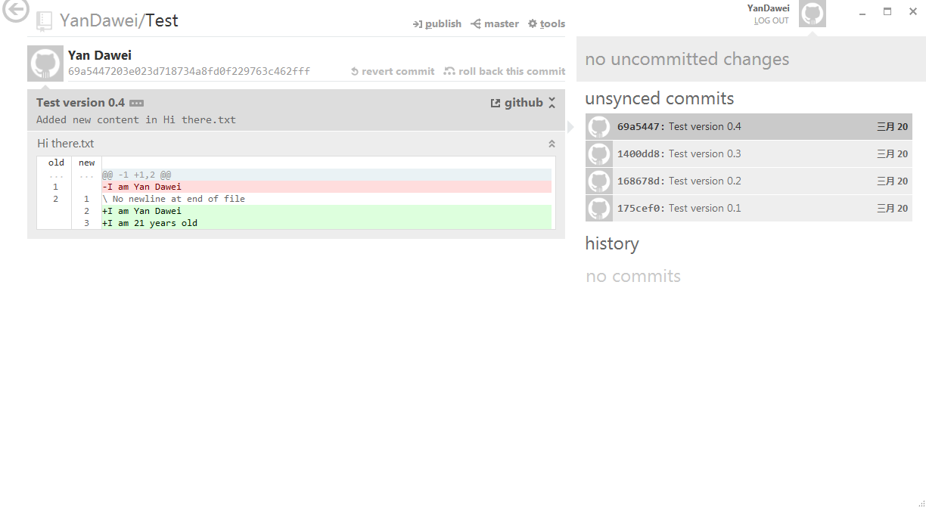
Rolling back and Reverting Commits
Here, I have done 2 more commits, by adding and editing some contents within the HI there text file. We will now use the rollback function again to better understand its mechanics. We will proceed to rollback to version 0.2 commit again.

Slide 22
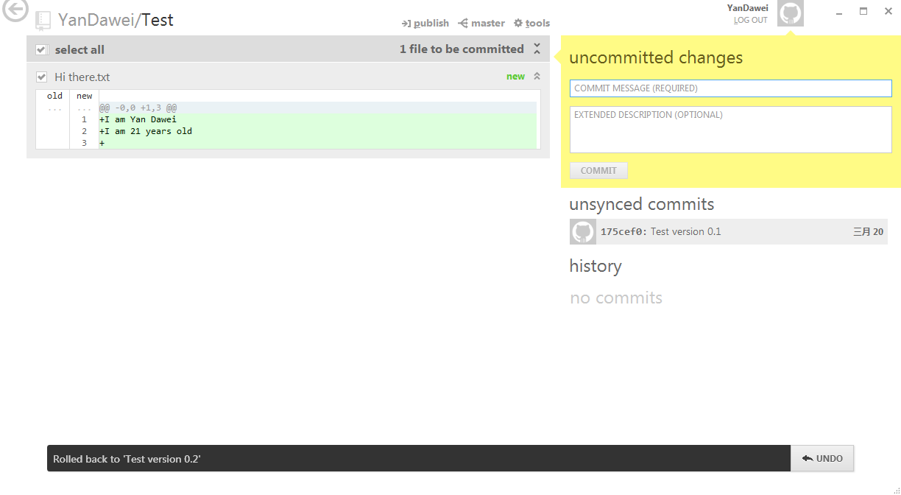
Rolling back and Reverting Commits
You should get this, all the previous commits after version 0.2 are gone and you are back to the uncommitted change of the newly addedd Hi there textfile.

Slide 23
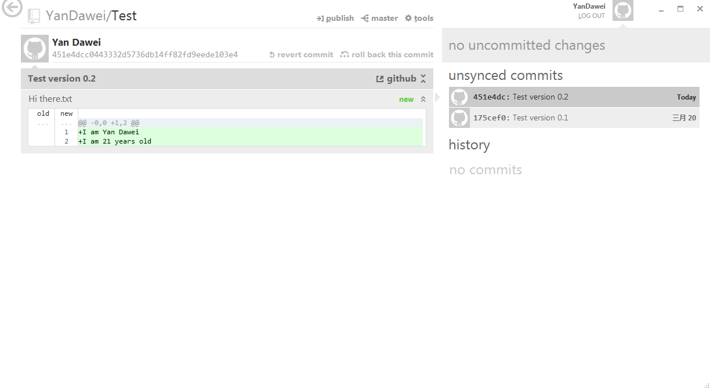
Rolling back and Reverting Commits
Now that we have explored the rollback feature, let us investigate the revert commit feature. We will transform our repo back into its base status with its two commits.

Slide 24
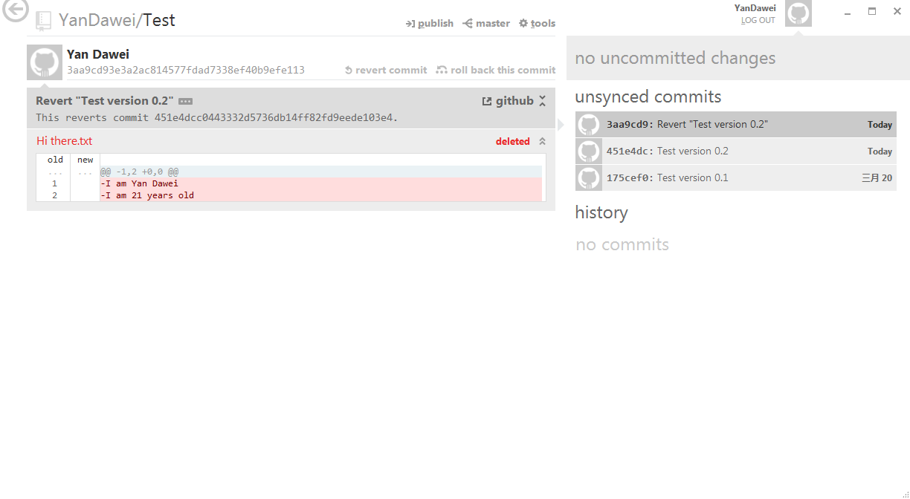
Rolling back and Reverting Commits
As you can see, the revert commit function will create a new commit that undoes the changes of the commit that you chose to revert. In this case, the revert that I just did removed the Hi there text file.

Slide 25
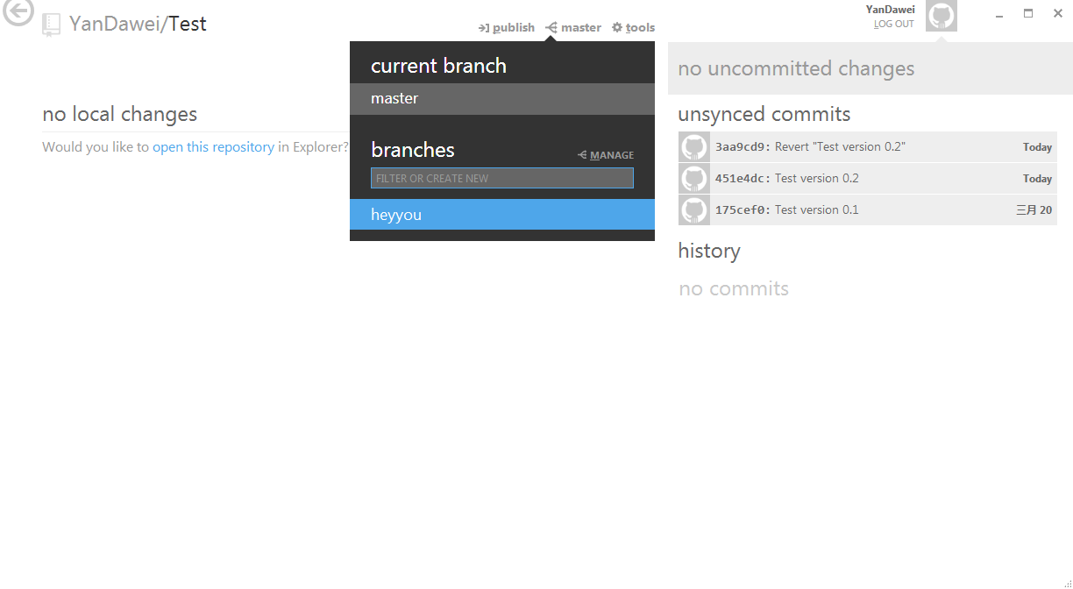
Switching branches
To switch to another branch, click on the branch icon as shown in this screenshot. Here I will proceed to switch to my newly created “heyyou” branch. Note the default branch is the “master”.

Slide 26
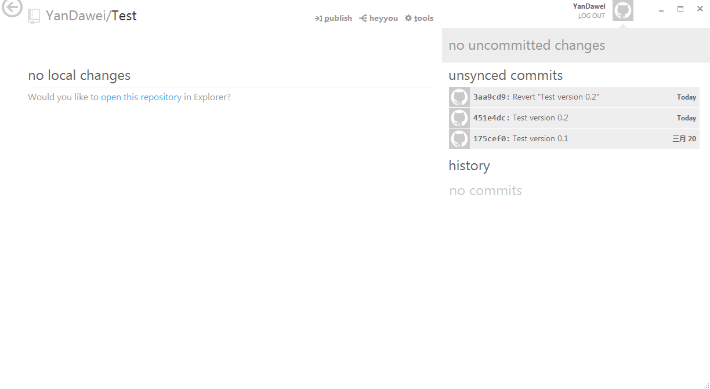
Switching branches
Here you can see that the heyyou branch is a replica of the master branch. When you create a new branch off from the master, it automatically replicates the master branch and its state (the commits in the master branch).

Slide 27
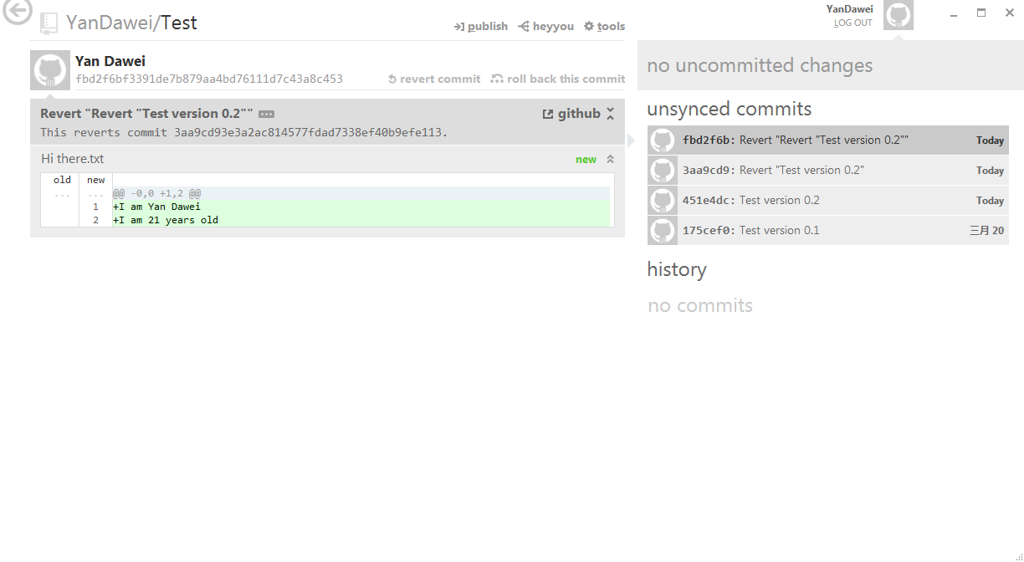
Merging Branches
To demonstrate the merging feature, i will make some changes to the Hi there text file in my “heyyou” branch. Here, to make it simple, I have reverted the latest commit to create a new commit. Thus, the latest revert brought back my Hi there text file.

Slide 28
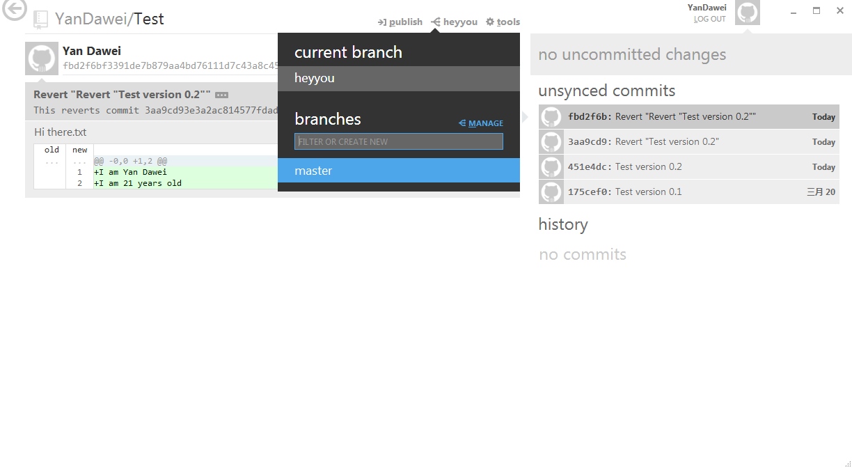
Merging Branches
To access the merge menu, click on the manage sign.
I shall now proceed to merge the “heyyou” branch with my master branch. Note that the fourth commit which I did in this branch, “Revert “Revert “Test version 0.2”” is only present in this branch. If you switch to the master branch, you should see only three commits.

Slide 29
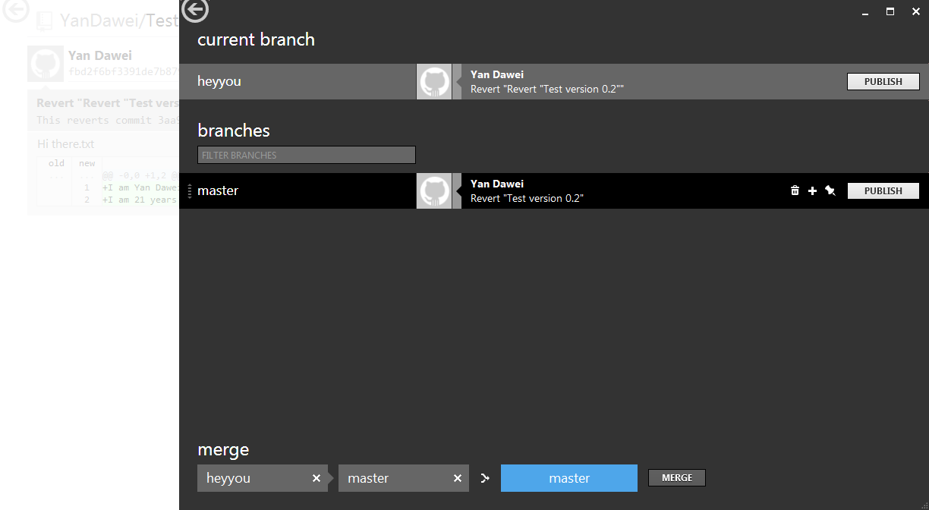
Merging Branches
Here, you will get to see all your branches. To merge any two branch, drag and drop the branches in the below containers. We shall do a merge and see what happens.

Slide 30

Merging Branches
This is the result of the merge, I am back in my master branch and you can see the change in my “heyyou” branch is now present in my master branch.

Slide 31

Publishing your repos
Publishing your repo basically means, creating a copy of the contents of your local repo and pasting it into your remote repo on Git Hub. As you can see all my commits are currently unsynced, which means that my Remote repo is not in sync with my local repo. To make both in sync press the publish button on top. Not that you can only be on one branch at a time, therefore if you wish to publish multiple branches, you have to manually switch to every branch and conduct a publish.

Slide 32
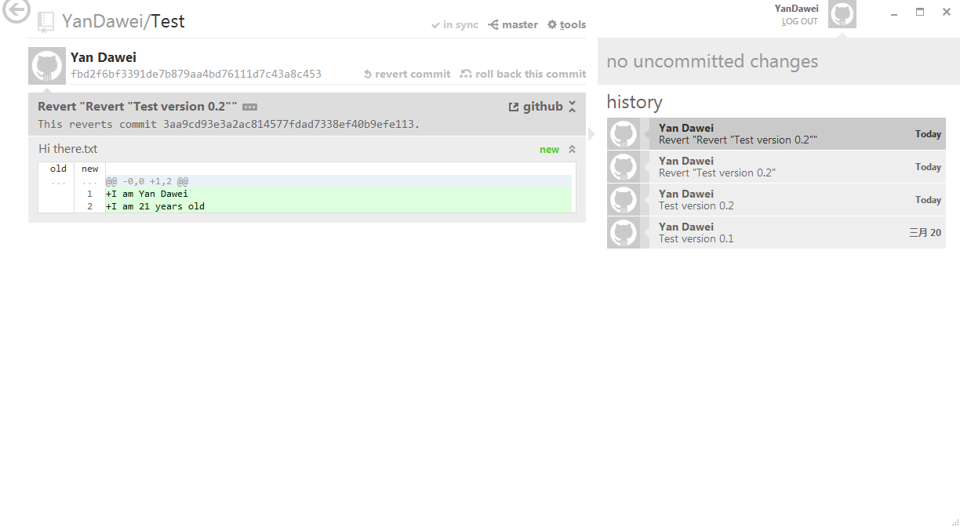
Syncing local and remote branches
After you initial publish, all you have to check to make sure that your remote repo is up to date with your local repo is to look here. If it says in sync, it means both your remote and local repos are on the same page.

Slide 33
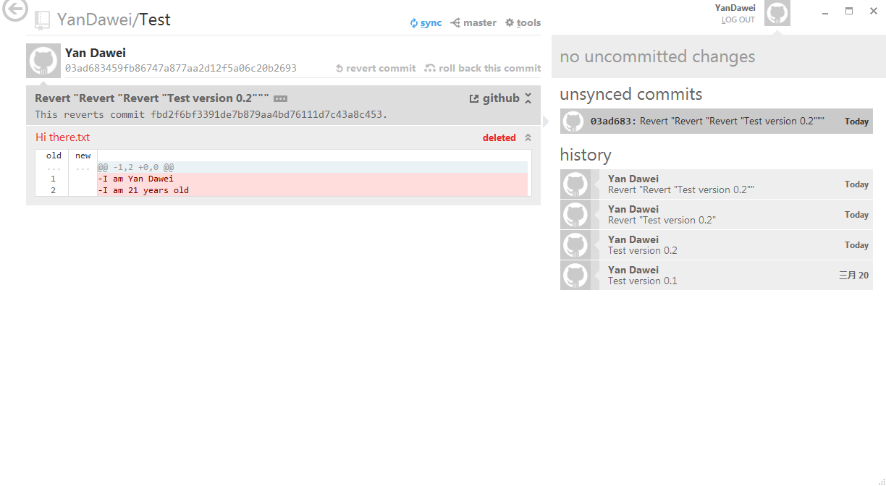
Syncing local and remote branches
If your remote repo is behind your local repo, you will be prompted to sync them by Git Hub. If you have a forked repo, then the reverse may happen, which is your local repo is behind your remote repo.

